Slide 1
Vision Statement
Save 36 million older Americans from falling down and getting hurt.
Mission Statement
Automate commonly used fall risk screening tools in a mobile application for faster, less expensive fall risk detection.
Augmented Fall Prevention for Physical Therapists
Notes:
HINT: This creates momentum and energy for the Team. You will need this energy and momentum for the next 10 to 25 years.
What do you do?
We seek to replace the keypad for 320,000 physical therapy professionals in the USA.
Currently, our mobile app uses a machine learning algorithm to digitize the most commonly used tests and measures required by PTs to justify therapy for insurance companies and Medicare.
The status quo is manual keyboard entry or pen-and-paper data recording followed by double data entry.
The EMR monopolizes the collection of data in the physical therapy clinic for several reasons:
mobile device and camera tools are not widely used, yet, in PT.
keyboard-dependant EMR tools have been subsidized by the Federal Government (HITECH Act)
Camera tools are not widely used due to concerns over Privacy and Security under Federal HIPAA regulations.
The healthcare industry is beset with regulations that limit innovation and discourage new entrants who are not license-holders.
Therapy professionals are change-averse and already burdened with heavy production schedules - any sort of change will be difficult unless it is an absolute, slam-dunk 10x improvement over the status quo.

Slide 2
What Problem Does VisualPT Solve?
An epidemic of Falls in older people:
Every 11 seconds an older person has a Fall with injury.
E-room visits from a Fall cost more than $14,000
1 in 4 older adults report falling every year.
36 million falls per year.
Notes:
DIAGNOTIC Screening app
Not Treatment
No FDA approval needed
There are 36 million older adults who will fall down in the next 12 months.
Each fall with injury costs the healthcare system ~$14k in the E-room.
We will screen and detect these falls BEFORE they happen.

Slide 3
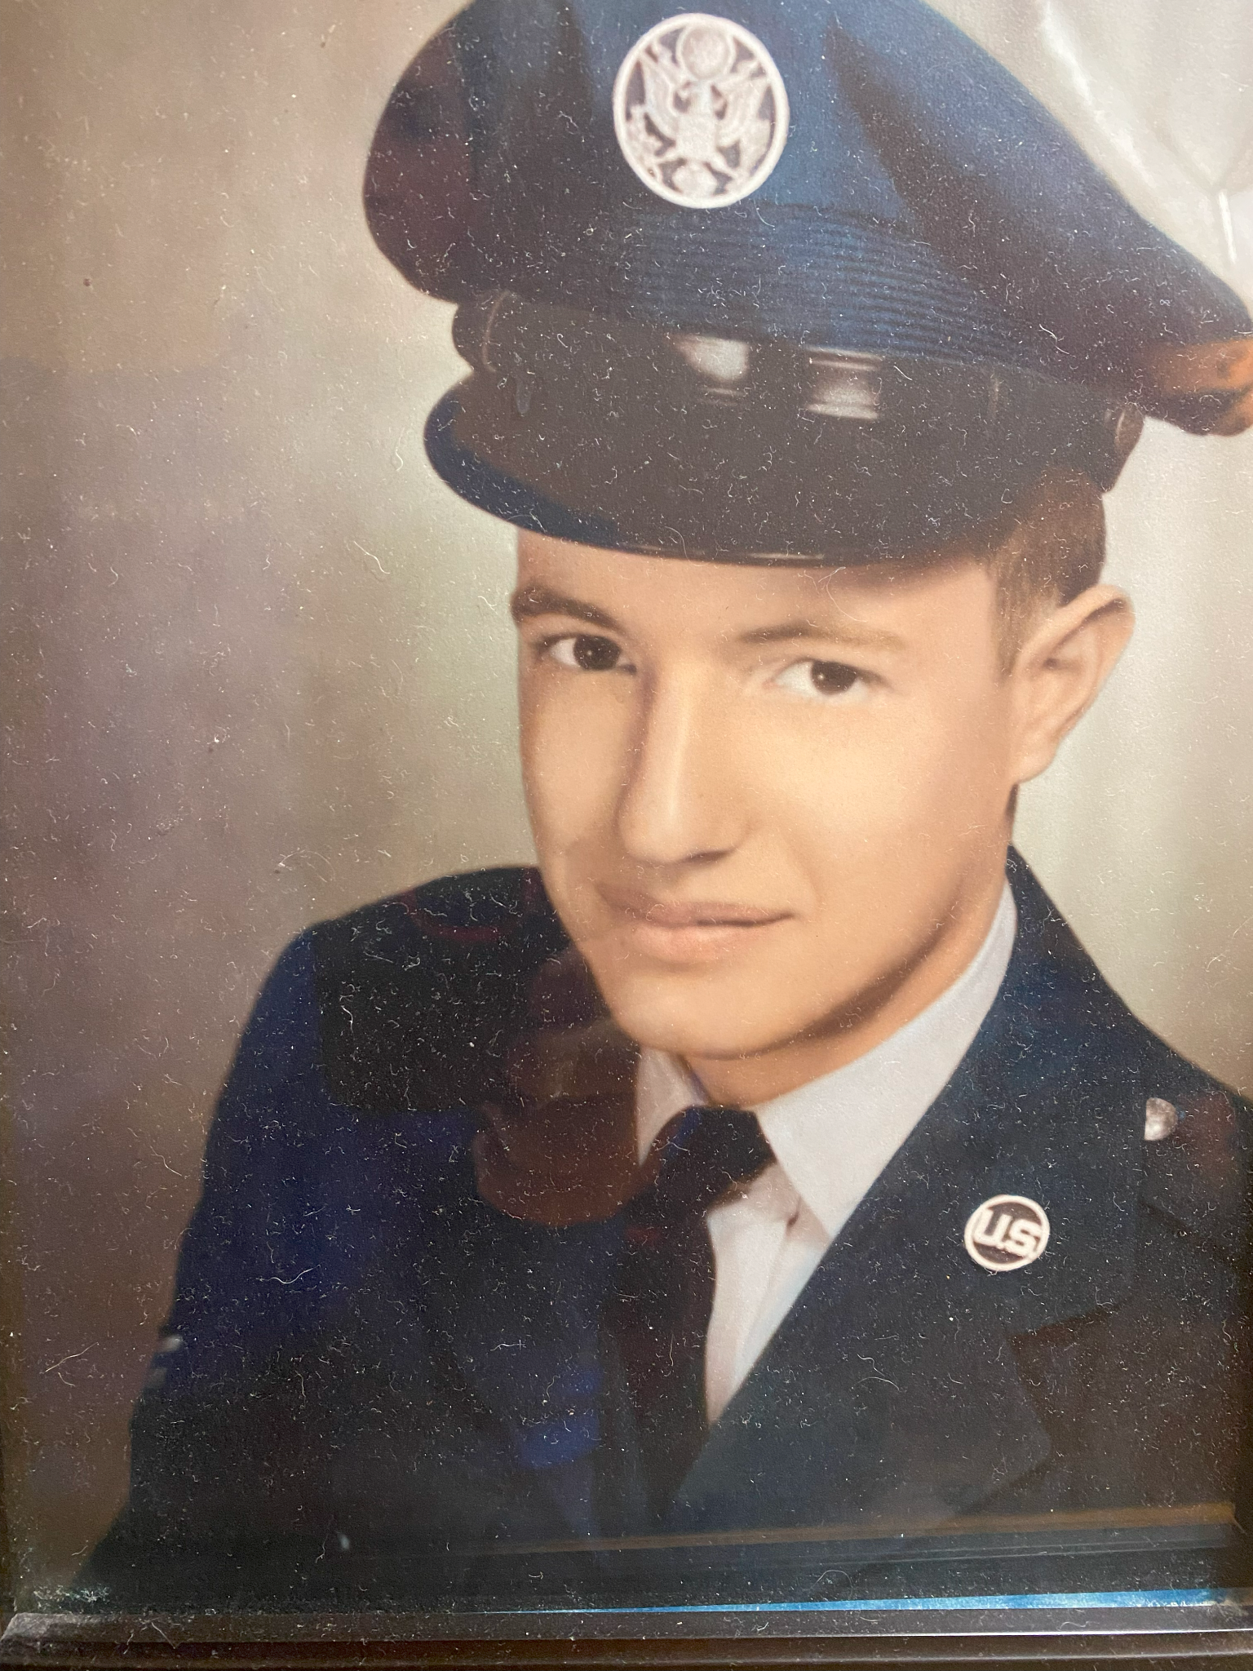
Dad

Slide 4
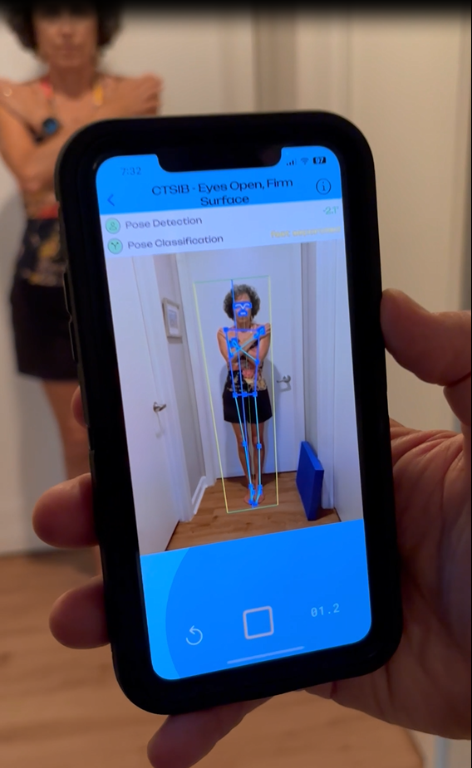
Solution
A 2-minute assessment using computer vision to replace a 20 minute pen-and-paper process.
Notes:
We're using a type of AI called Computer Vision to 100x the rate of fall risk screening in the United States.

Slide 5
Total Addressable Market (TAM):
Global Physical Therapy
software market, 2021
How Big is the Market?
TAM
$1.1 Billion
SAM
Serviceable Available
Market (SAM):
USA PT software
10% CAGR, 2022-2030
$456.4 Million
SOM
Serviceable
Obtainable
Market (SOM):
16,000 outpatient PT clinics
22,000 skilled nursing facilities
5,000 hospitals
16k outpatient PT clinics
Notes:
Source:
GrandviewResearch.com

Slide 6
Outpatient Physical Therapy clinics
16,000 locations in the USA (market data)
X 10% market share
=======================================
1600 locations in 2 years
X $50 per licensed PT per month (note: most locations have more than 1 PT)
=======================================
$600 annual revenue per customer
X 1600 customers
=======================================
$960,000 annual revenue
Notes:
Conduct Scenario Analysis - establish high range/;low range
Contact APTA - average number # of PTs in an outpatient clinic.

Slide 7
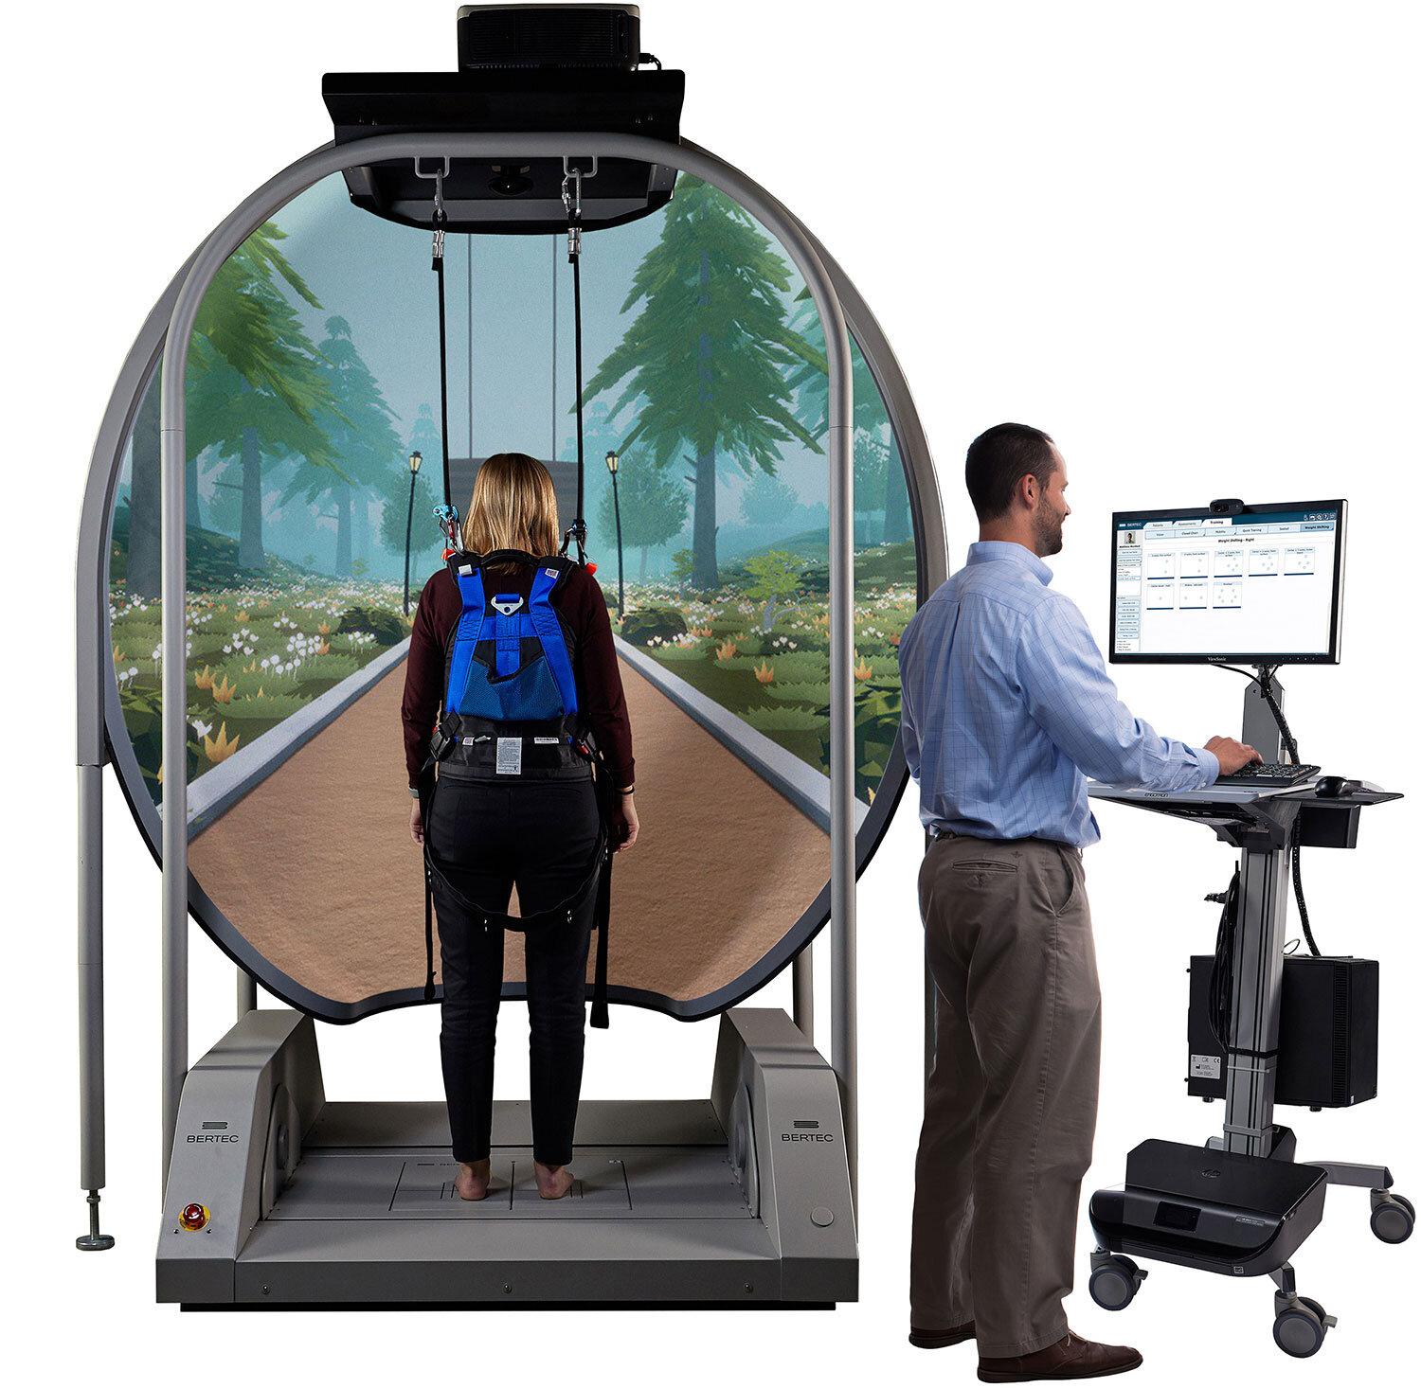
Competition
BodiTrak Cost: $5,000
Time: 15 min.
Natus /
NeuroCom Cost: $20,000 (used)
Time: 15 min.
Bertec: Cost: $87,000
Time: 15 min.
Notes:
We face well-established hardware incumbents who have a 50-year market dominance.
The market is ripe for disruption simply because current fall risk screening under-diagnoses the extent of the problem AND the incumbent hardware firms charge $5k to $87k for their technology.
We save doctors, clinics and hospitals over 100x on their current costs.

Slide 8
Advantages
10x less expensive
Mobile, not fixed - Measure the patient where they are.
Direct measure, not a calculation - computer vision, a type of AI.
Doesn’t break - No maintenance costs (Apple App store)
Smaller footprint than force plates
Faster than force plates
Direct link to EMR thru wireless API

Slide 9
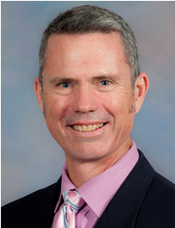
Regulatory Review
HIPAA Compliant
Trusted, third-party platform (AWS)
2-factor authentication
NO patient data (names, emails, diagnoses, tec) are retained in the system.
Food & Drug Administration - approval not needed. The app is a screening device, not a diagnostic device.
Institutional Review Board (IRB)
“CTSIB is already a validated test; well-known in the PT community.
At this time, there is no need for IRB approval to begin validation & data collection.”
Dr. Mark Bishop,
Chair, UF Dept. of PT
Notes:
A/P measurement - Nick speaks about A/P estimation using ‘synthetic data’ & LIDAR.

Slide 10
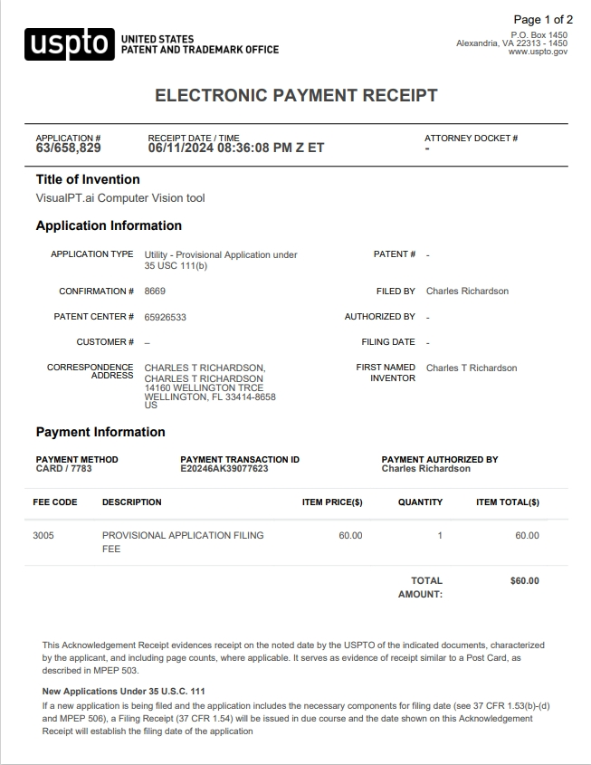
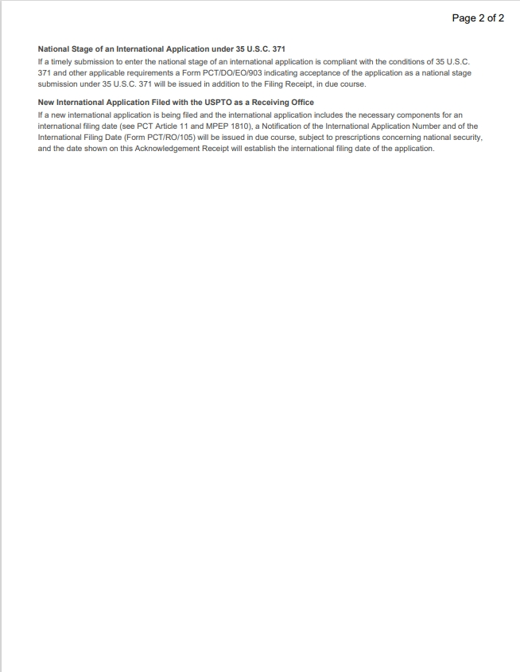
Patent Pending
Provisional patent #: 65/658,829
Expiration date: June 11, 2025

Slide 11
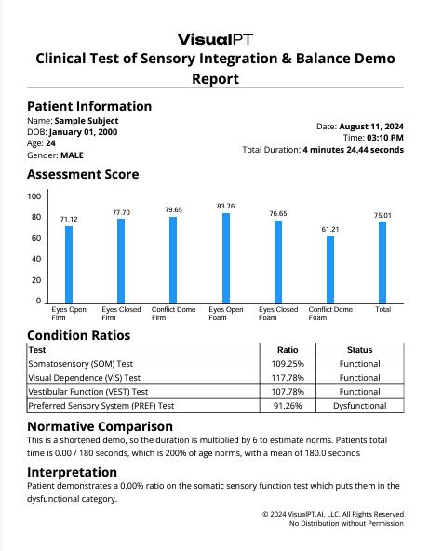
Written PDF Report
Today: Billable as 97750 = $33.57
Supports Medical Necessity for Physical Therapy
Identifies High Fall Risk Seniors

Slide 12
Next Steps
Add new Tests: Industry Gold Standards - no more manual tests!
Build API data pipeline to EMRs - no more paper!
Text snippets with generative AI - reduce keyboard time!
Gyroscopic image stabilization - no need for a tripod!

Slide 13
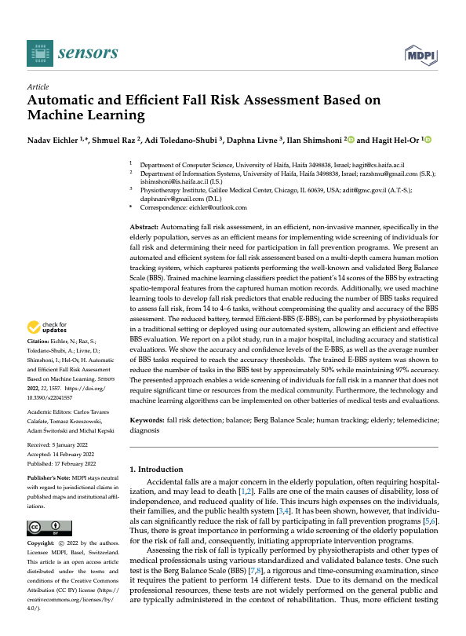
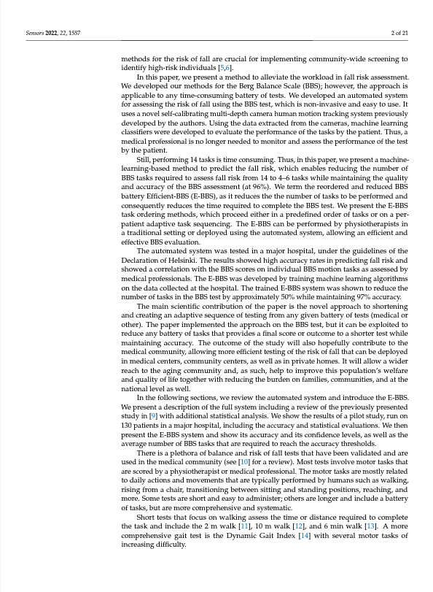
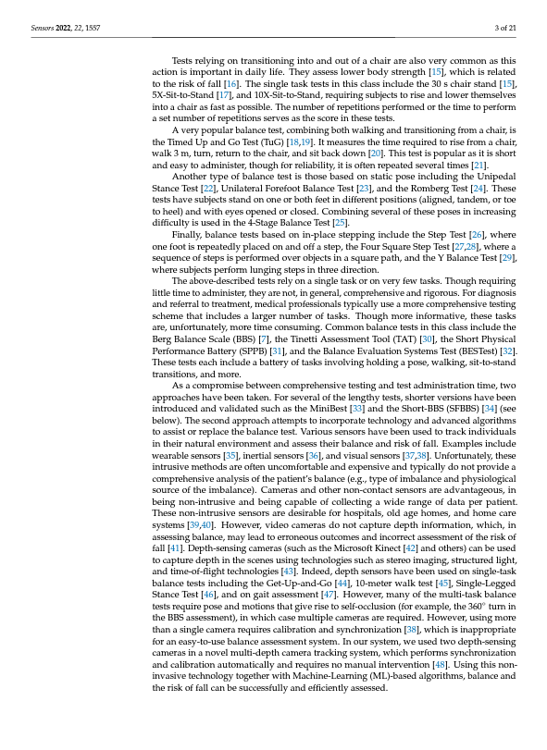
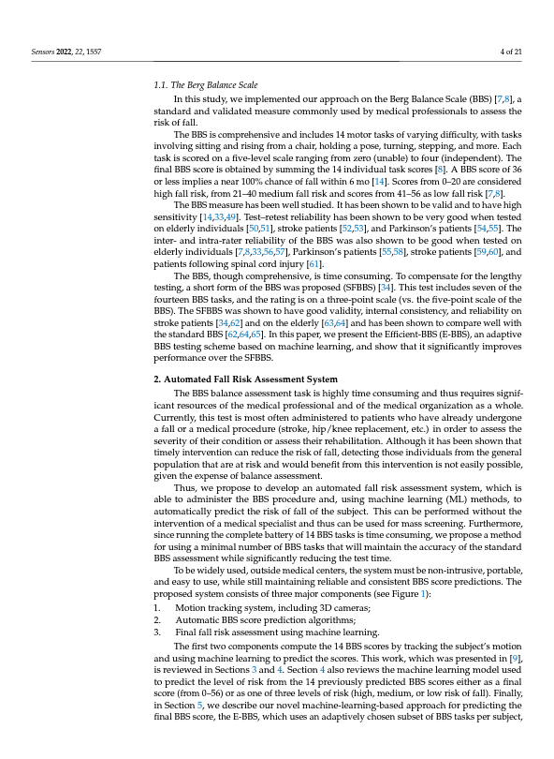
Next Steps
Berg Balance Test
Machine Learning model collapses 14 test items down to 4 items (1 already collected on the CTSIB).
https://www.ncbi.nlm.nih.gov/pmc/articles/PMC8875808/pdf/sensors-22-01557.pdf

Slide 14
Next Steps
EMR
API to EMR
https://www.ncbi.nlm.nih.gov/pmc/articles/PMC8875808/pdf/sensors-22-01557.pdf

Slide 15
Generative AI - Text Snippets
Next Steps
Pre-filled 75% of the Daily PT Note
Raw data - supplements the “O”
Assessment data - supplements the “A”
Fall Risk data - supplements the “P”

Slide 16
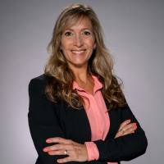
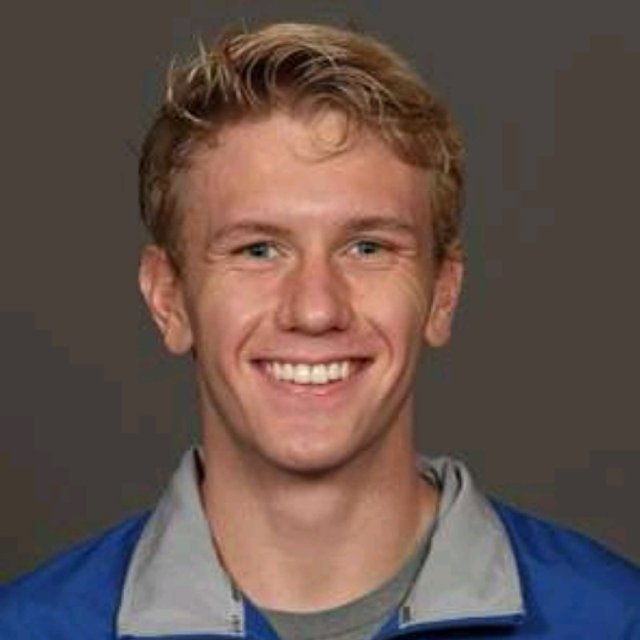
Team
Charles Richardson, Founder
UI/UX front-end developer
Software Engineer @ Agriculture Intelligence
Holly Scott, Principal
Vice President & Partner at The Mullings Group | Global Medical Device & Life Sciences | Executive Search-Building Companies and Careers
Nick Fox, Principal
DevSecOps Engineer at CAE and Machine Learning Engineer | Graduate Studies at Georgia Institute of Technology | Active Top Secret Clearance
Tim Richardson, Consultant
Physical Therapist & Franchise Regional Consultant, FYZICAL LLC

Slide 17
Franchise Licensing
Big PT Company
600 locations

Slide 18
Ask
Inside Sales professional
$5k / month (commission based) x 6 mos. = $30k
Web driven sales platform / funnel
$3k / month x 6 mos. = $18k
Dev Team: $3k/mo. = $18k
Total Ask: $66k
Total expected return: 400 paying customers

Slide 19
Thank you!
Tim Richardson, PT
CELL: 1.941.623.6109
Email: Tim.Richardson@VisualPT.ai

