Slide 1
Vision Statement
Save 36 million older Americans from falling down and getting hurt.
Mission Statement
Automate commonly used fall risk screening tools in a mobile application for faster, less expensive fall risk detection.
Augmented Fall Prevention for Physical Therapists
Notes:
HINT: This creates momentum and energy for the Team. You will need this energy and momentum for the next 10 to 25 years.
What do you do?
We seek to replace the keypad for 320,000 physical therapy professionals in the USA.
Currently, our mobile app uses a machine learning algorithm to digitize the most commonly used tests and measures required by PTs to justify therapy for insurance companies and Medicare.
The status quo is manual keyboard entry or pen-and-paper data recording followed by double data entry.
The EMR monopolizes the collection of data in the physical therapy clinic for several reasons:
mobile device and camera tools are not widely used, yet, in PT.
keyboard-dependant EMR tools have been subsidized by the Federal Government (HITECH Act)
Camera tools are not widely used due to concerns over Privacy and Security under Federal HIPAA regulations.
The healthcare industry is beset with regulations that limit innovation and discourage new entrants who are not license-holders.
Therapy professionals are change-averse and already burdened with heavy production schedules - any sort of change will be difficult unless it is an absolute, slam-dunk 10x improvement over the status quo.

Slide 2
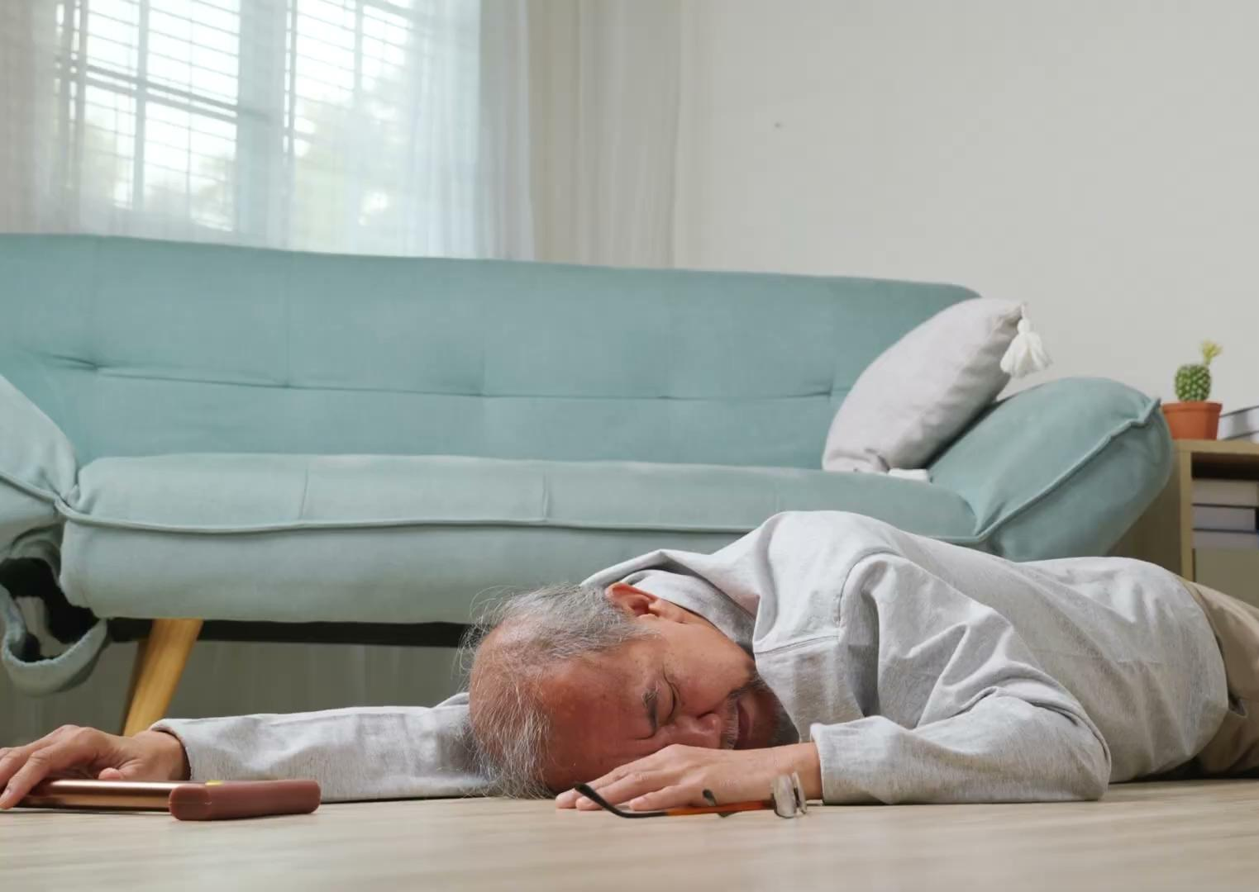
What Problem Does VisualPT Solve?
An epidemic of Falls in older people:
Every 11 seconds an older person has a Fall with injury.
E-room visits from a Fall cost more than $14,000
1 in 4 older adults report falling every year.
36 million falls per year.

Slide 3
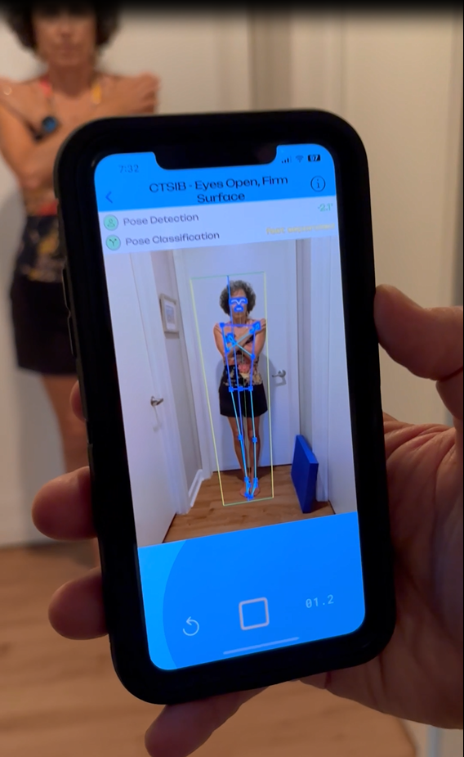
Solution
A 2-minute assessment using computer vision to replace a 20 minute pen-and-paper process.

Slide 4
Total Addressable Market (TAM):
Global Physical Therapy
software market, 2021
How Big is the Market?
TAM
$1.1 Billion
SAM
Serviceable Available
Market (SAM):
USA PT software market, 2022
$456.4 Million
10% CAGR, 2022-2030
SOM
Serviceable
Obtainable
Market (SOM):
16,000 outpatient PT clinics
22,000 skilled nursing facilities
5,000 hospitals
Notes:
Source:
GrandviewResearch.com

Slide 5
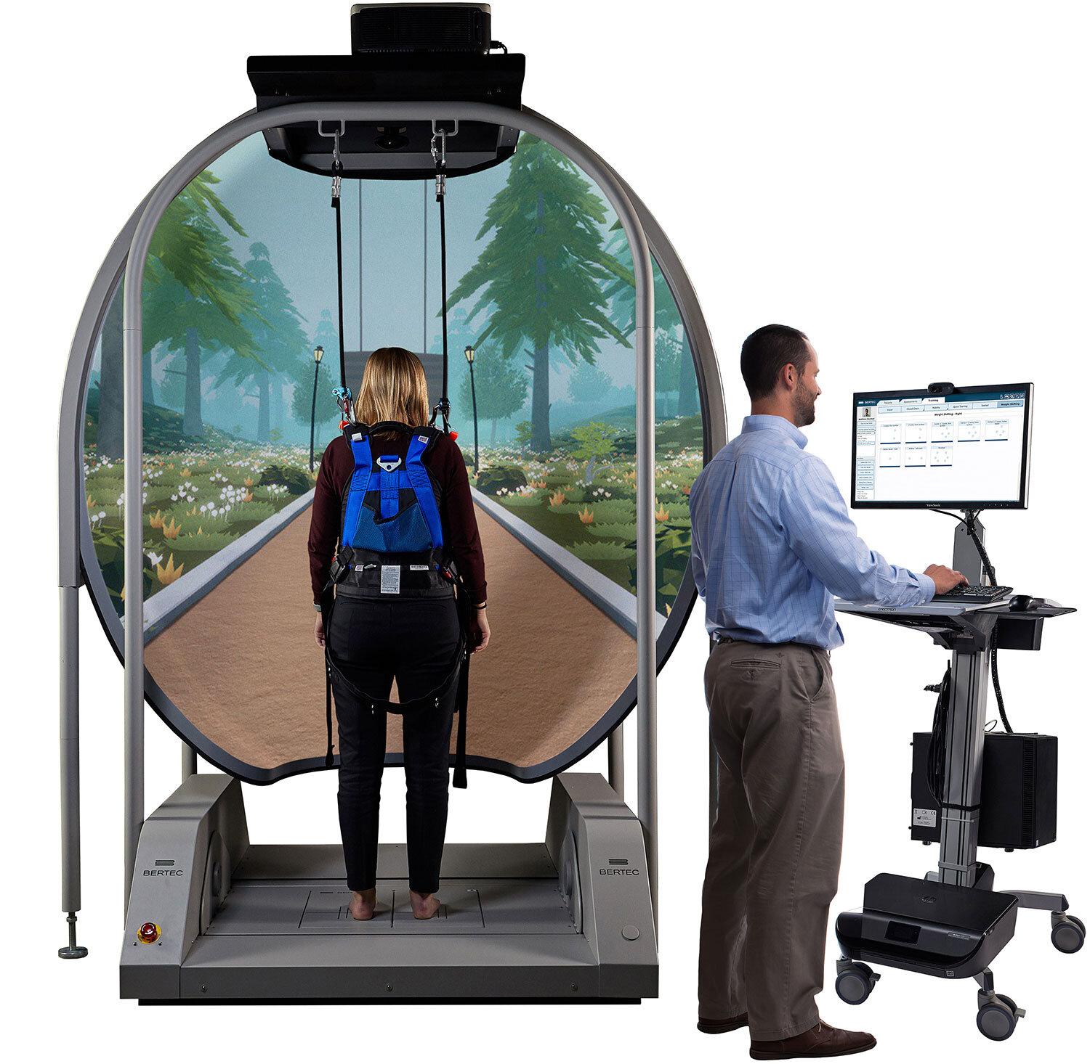
Competition Market Share
BodiTrak Cost: $5,000
Time: 15 min.
Natus /
NeuroCom: ~$20,000 (used)
Time: 15 min.
(discontinued)
Bertec: Cost: $87,000
Time: 15 min.
Company
125 BodiTrak
27 Bertec
—————
600 locations
PT Industry
X BodiTrak = 21% market share (est.)
X Bertec = 4.5% market share (est.)
————— ——————————
16,000 PT locations 25.5% market share
4,000 PT clinics in USA use force plates for Falls Risk screening.

Slide 6
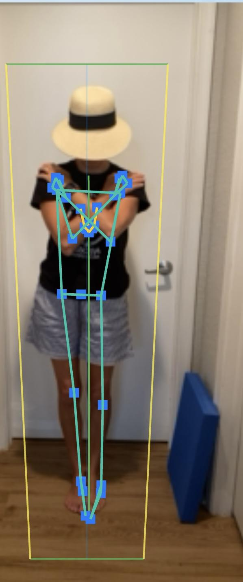
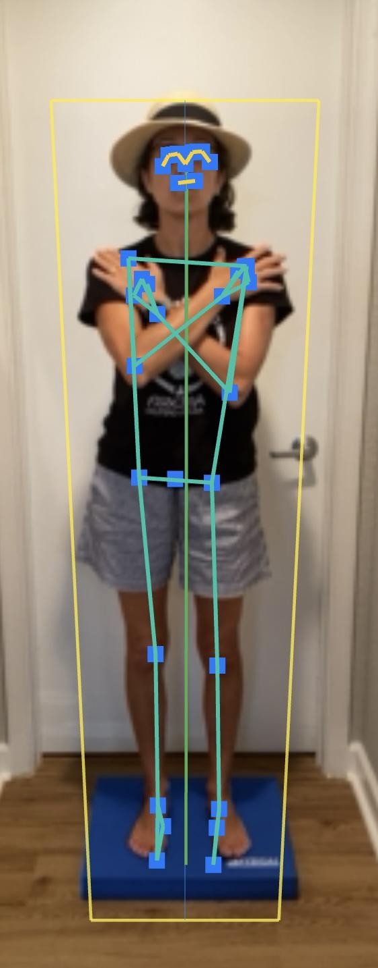
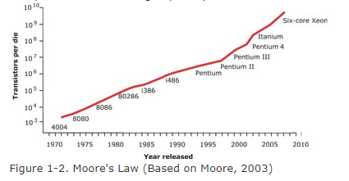
Why now?
https://developers.google.com/static/ml-kit/images/vision/pose-detection/pose_model_card.pdf
MediaPipe BlazePose GHUM 3D (Google)
Notes:
“A Data warehouse in the palm of your hand”
“The solutions to these problems lies underneath Moore’s Law.”

Slide 7
Data Flow - EMR agnostic
PT notes
EMR
EMR
data
EMR
Executive Data Dashboard
EMR
EMR

Slide 8
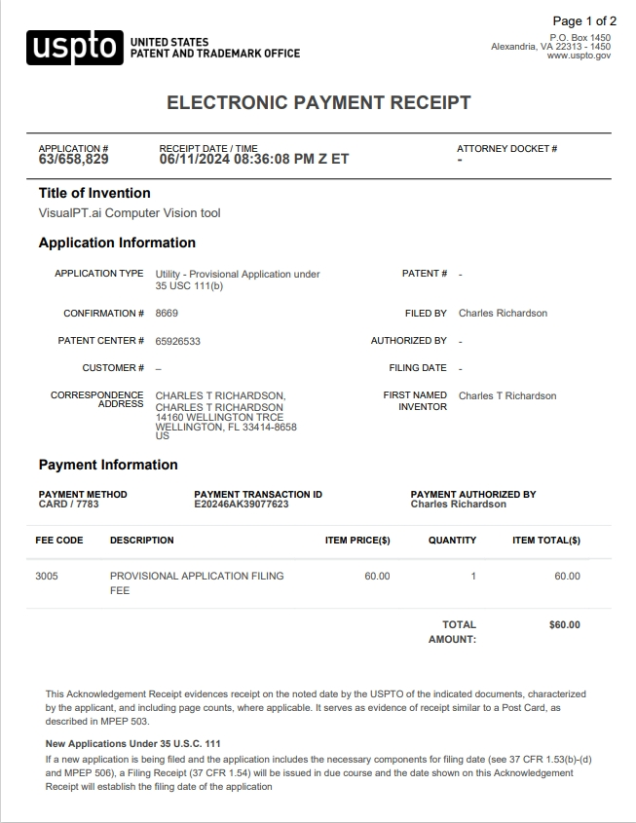
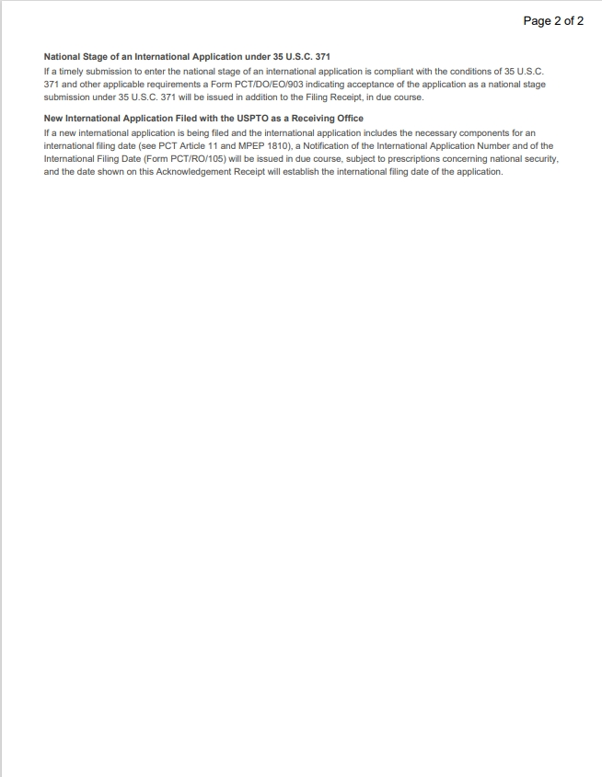
Patent Pending
Provisional patent #: 65/658,829
Expiration date: June 11, 2025

Slide 9
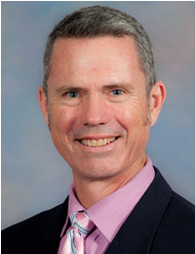
Regulatory Review
HIPAA Compliant
Trusted, third-party platform (AWS)
2-factor authentication
NO patient data (names, emails, diagnoses, tec) are retained in the system.
Institutional Review Board (IRB)
“CTSIB is already a validated test; well-known in the PT community. At this time, there is no need for IRB approval to begin validation & data collection.”
Dr. Mark Bishop,
Chair,
UF Dept. of PT
Notes:
A/P measurement - Nick speaks about A/P estimation using ‘synthetic data’ & LIDAR.

Slide 10
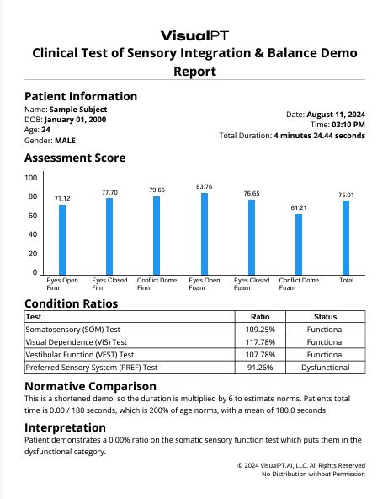
Written PDF Report
Billable as CPT 97750 = $33.57
Supports Medical Necessity for Physical Therapy
Identifies High Fall Risk Seniors
Next Steps: Use Data and Text from the Written Reports as an LLM Text Prompt to augment the PT Daily Note.

Slide 11
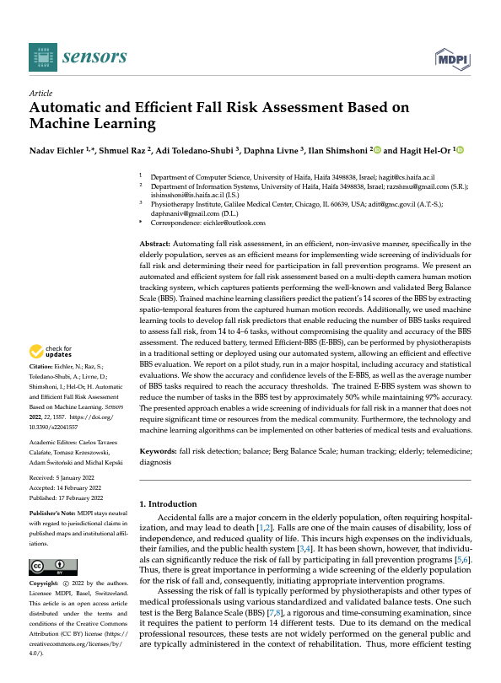
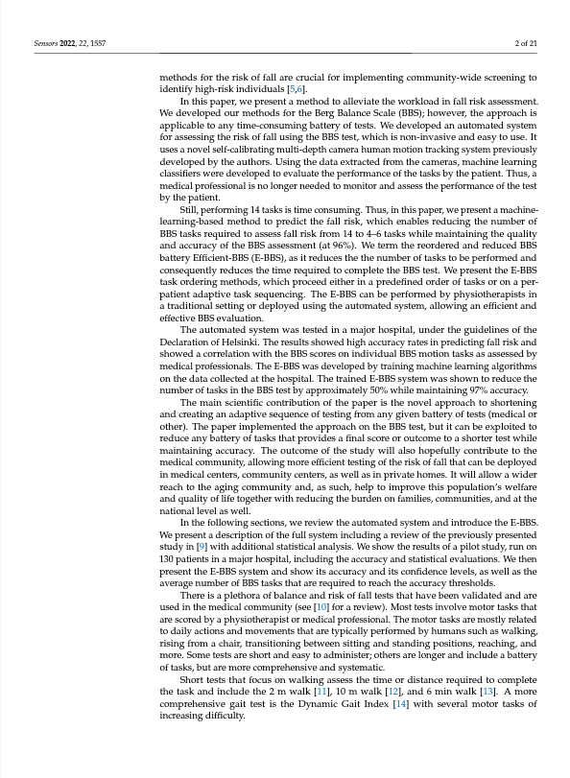
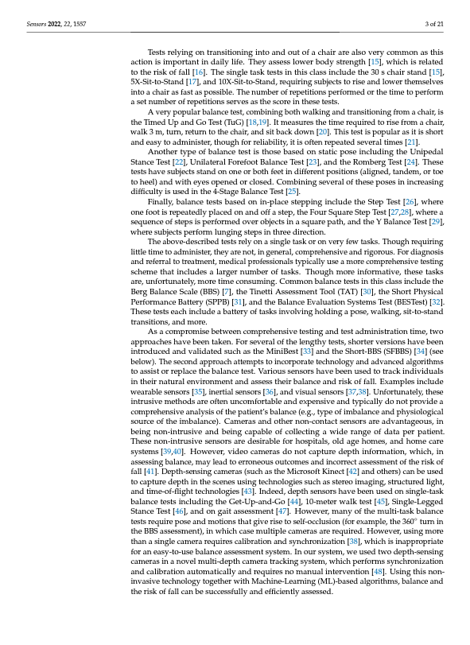
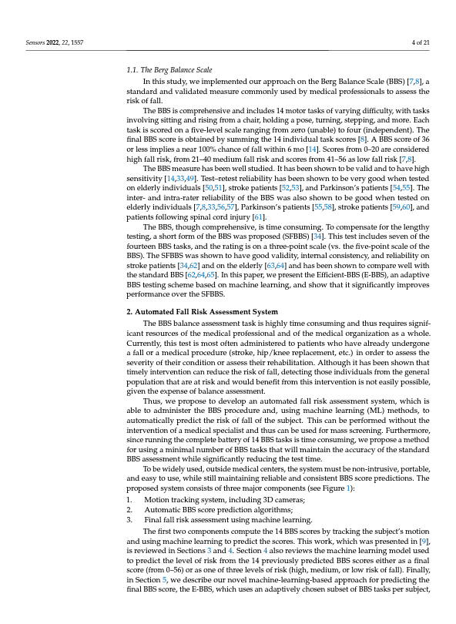
Next Steps
Berg Balance Test - Machine Learning model collapses 14 test items down to 4 items (1 already collected on the CTSIB).
https://www.ncbi.nlm.nih.gov/pmc/articles/PMC8875808/pdf/sensors-22-01557.pdf

Slide 12
Generative AI - Text Snippets
AI-generated, 75% of the Daily PT Note
Raw data - supplements the “O”
Assessment data - supplements the “A”
Fall Risk data - supplements the “P”

Slide 13
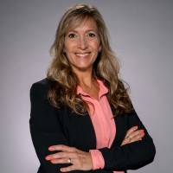
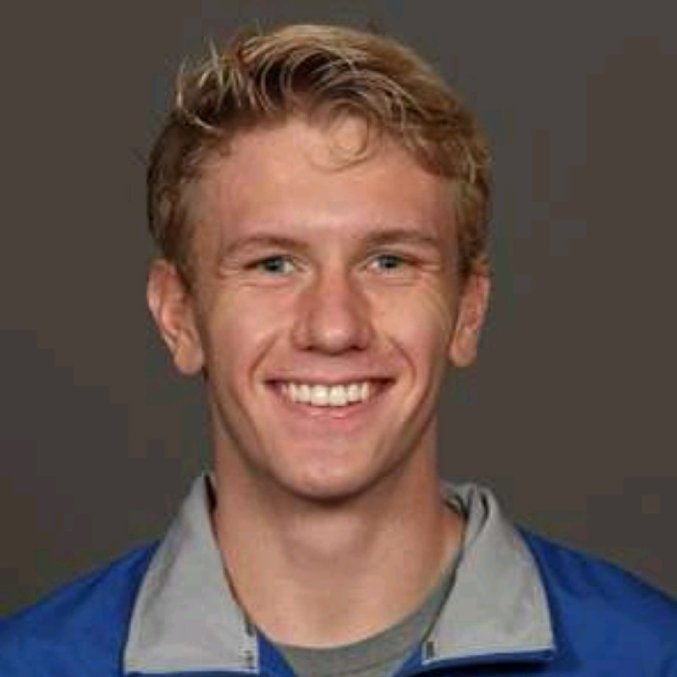
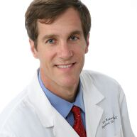
Team
Charles Richardson, Founder
UI/UX front-end developer
Software Engineer @ Agriculture Intelligence & VisualPT
Holly Scott, Principal
Vice President & Partner at The Mullings Group | Global Medical Device & Life Sciences | Executive Search-Building Companies and Careers
Nick Fox, Principal
DevSecOps Engineer at CAE and Machine Learning Engineer at VisualPT.ai | Student at Georgia Institute of Technology | Active Top Secret Clearance
Tim Richardson, Consultant
Physical therapist & Franchise Regional Consultant, FYZICAL LLC.

Slide 14
Thank You!

